Slide 1
Pythagorean Theorem

Slide 2
Area of rectangle
Area (rectangle) = width x length
What is the area of the rectangle below?
width
length

Slide 3
Area of Parallelogram
Area (parallelogram) = base x height
What is the area of the parallelogram below?
height
base

Slide 4
Triangle
Area (triangle) = $\frac{\text{base} \text{x} \text{height}}{\text{2}}$
What is the area of the triangle below?
height
base

Slide 5
Area of a square?

Slide 6
Outline
Square of a number
Right Triangle
Pythagorean Theorem

Slide 7
Square of a Number
Definition: The square of a number n is n×n, denoted by n².
We may also say n squared for the square of n.
Example:
The square of 3 is 3² = 3×3 = 9.
The square of 4 is 4² = 4×4 = 16

Slide 8
Practice
What is the square of 5?
What is the square of 6?
How do you read the mathematical sentence below?
7² = 49

Slide 9
Questions:
Why do you think that n×n is called the square of n?
What do you think that n×n×n is called?

Slide 10
Right Angle
Perpendicular
The name comes from latin “angulus rectus”. “Rectus” means upright.
A right angle is exactly half of an straight angle (the two rays are on a same line).
Right Angle
Right Angle

Slide 11
Right Triangle
A triangle that has a right angle is called a right triangle.
Hypotenuse
Right Angle

Slide 12
Practice
Draw a right triangle with sides:
3 cm, 4 cm, and ? long.
5 cm, 12 cm, and ? long.
Hints:
Draw the given sides at a right angle
Measure the hypotenuse
Notes:
Insert movie of drawing the triangles using graph paper and compass.

Slide 13
Theorem
Definition: A theorem is a mathematical statement that has been proven to be true.
How do we prove a theorem?
We start with some statements accepted to be true, called axioms.
Use logical deduction to find new true statements.
Can you think of some true statements that you learned about lines and points?

Slide 14
Axioms
A straight line segment can be drawn joining any two points.
Any straight line segment can be extended forever in a straight line.

Slide 15
Pythagorean Theorem
In a right triangle, the square of the length of the hypotenuse is equal to the sum of the squares of the lengths of the two other sides.
Example: Given a right triangle with sides of length 3, 4, and 5, we have:
3² + 4² = 9 + 16 = 25
5² = 25
Hypotenuse
Right Angle

Slide 16
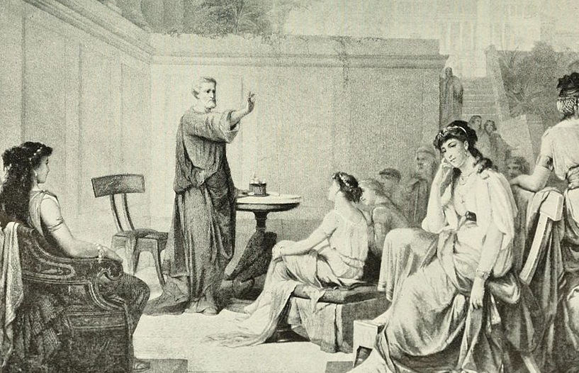
How old is this theorem?
About 4000 years old.
Known in ancient cultures (Babylonian, Indian, and Chinese)
Formalized by Pythagoras or one of his followers, about 2500 years ago.
Notes:
By Internet Archive Book Images - https://www.flickr.com/photos/internetarchivebookimages/14783288925/Source book page: https://archive.org/stream/storyofgreatestn01elli/storyofgreatestn01elli#page/n586/mode/1up, Public Domain, https://commons.wikimedia.org/w/index.php?curid=42033593

Slide 17
What does the theorem mean?
First, we start with a right triangle.
Next, we give some names to the sides.
“the square of the hypotenuse is equal to the sum of the squares of the two other sides.”
c
a
c² = a² + b²
b

Slide 18
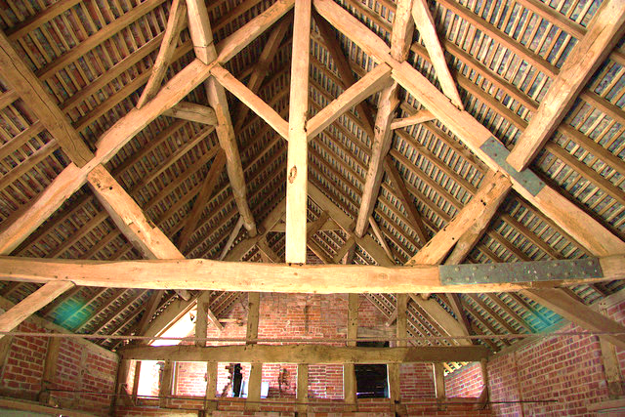
How is it used in practice?
How long should this be?
Roof Height
Half of house width

Slide 19
Proof Idea
a
c
b
a
b

Slide 20
a
b
Notes:
How can we move the gray triangles to have left a square with side c?

Slide 21
c
b
a

Slide 24
c
b
c
b
a
a
a
c
b
c
b
a
b
a
a² + b² = c²
Notes:
How does this prove the theorem? Grey + green + red = grey + white

Slide 25
Details …
The shape in the middle in the second square is also a square.
The overlap between the shapes is of area zero.

Slide 26
Practice
Use the Pythagorean theorem to find out the missing value:
6
?
8

Slide 27
Practice
Use the Pythagorean theorem to find out the missing value:
13² = 169
12² = 144
13
?
12

Slide 28
Pythagorean Triples
A triple a, b, c with a² + b² = c² is called a Pythagorean triple.
13
10
5
5
6
3
4
12
8
Challenge: Find other Pythagorean Triples!

Slide 29
Thank you!

